Slide 1


Tech Insights Group
Laptop Pricing Analysis
An in-depth exploration of 5000 laptops, examining pricing, specifications, performance metrics, and overall value to aid consumer choices.
Idris Shah, Data Analyst
NOVEMBER 2025

Slide 2
Project Objective
Pricing Analysis
Analyzing pricing helps identify trends and various factors influencing laptop costs, aiding in better purchasing decisions.
Understanding Laptop Pricing Dynamics
This project aims to analyze the complex relationship between laptop pricing, specifications, performance, and overall value metrics to guide informed consumer choices.
Consumer Decision-Making
Understanding how specs affect pricing empowers consumers to choose the best laptops according to their needs and budgets.
Market Positioning
Insights derived from this analysis will assist brands in determining strategic pricing for effective market positioning and competitive advantage.

Slide 3


Dataset Overview
This section presents an overview of our dataset, comprising 5000 laptops analyzed for key attributes such as RAM, storage, processor, battery life, operating system, performance score, price, and discount. Additionally, derived fields like the Value-for-Money (VFM) score, Overpriced score, and Price category offer insightful metrics for analysis.

Slide 4
Data Cleaning & EDA Summary
Removing Duplicates
Duplicate entries were meticulously identified and removed to ensure data integrity.
Essential steps for dataset preparation
This section outlines the crucial steps taken in cleaning and preparing the dataset for analysis.
Handling Missing Values
Missing values were addressed using appropriate imputation techniques to maintain analysis accuracy.
Price Segmentation
Prices were categorized into defined segments to facilitate clearer analysis and comparison.

Slide 5
Key Charts
Overview
Price Distribution
The price distribution chart shows a wide range of laptop prices across the dataset.
Visualizing Laptop Pricing Trends
This section highlights key charts illustrating the relationship between pricing and specifications of laptops.
RAM vs Price
The RAM versus price chart indicates how memory size correlates with pricing trends.
Storage vs Price
The storage versus price chart reveals the impact of storage capacity on laptop pricing.

Slide 6
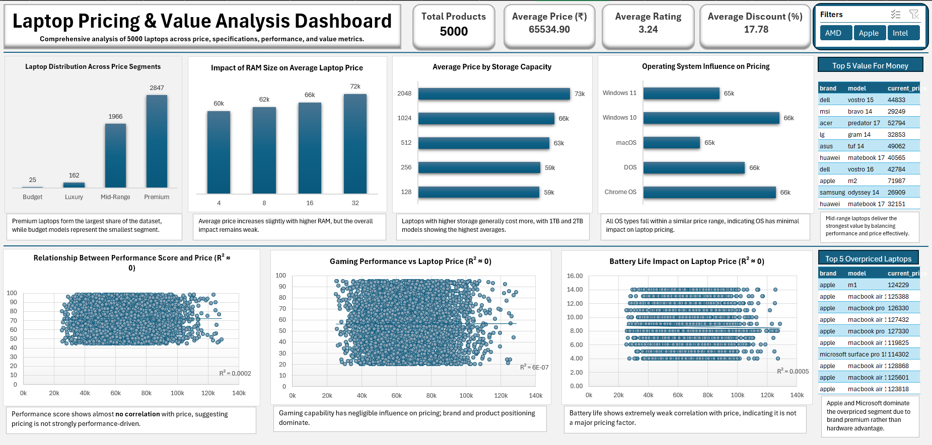

Slide 7

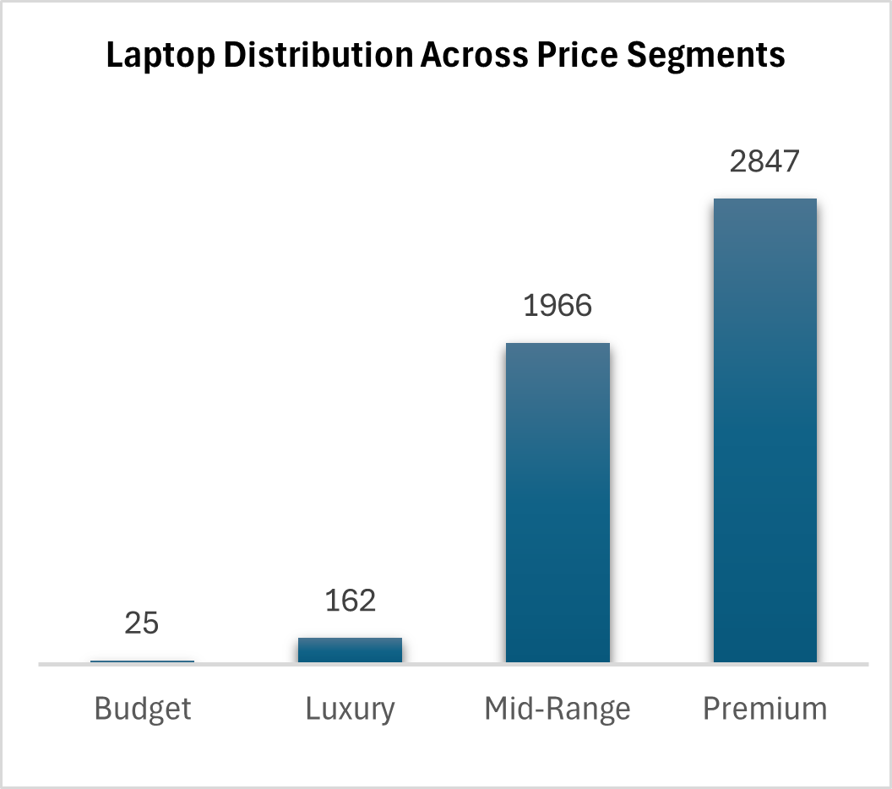
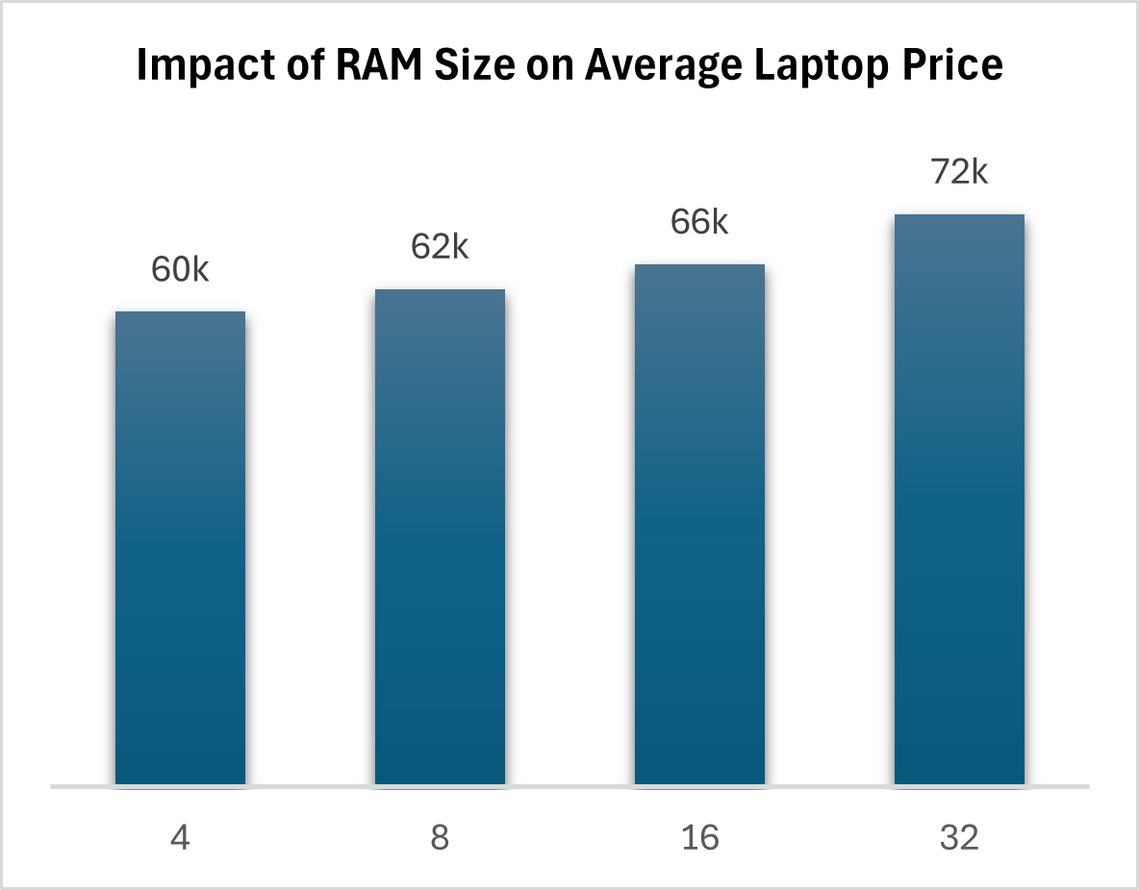
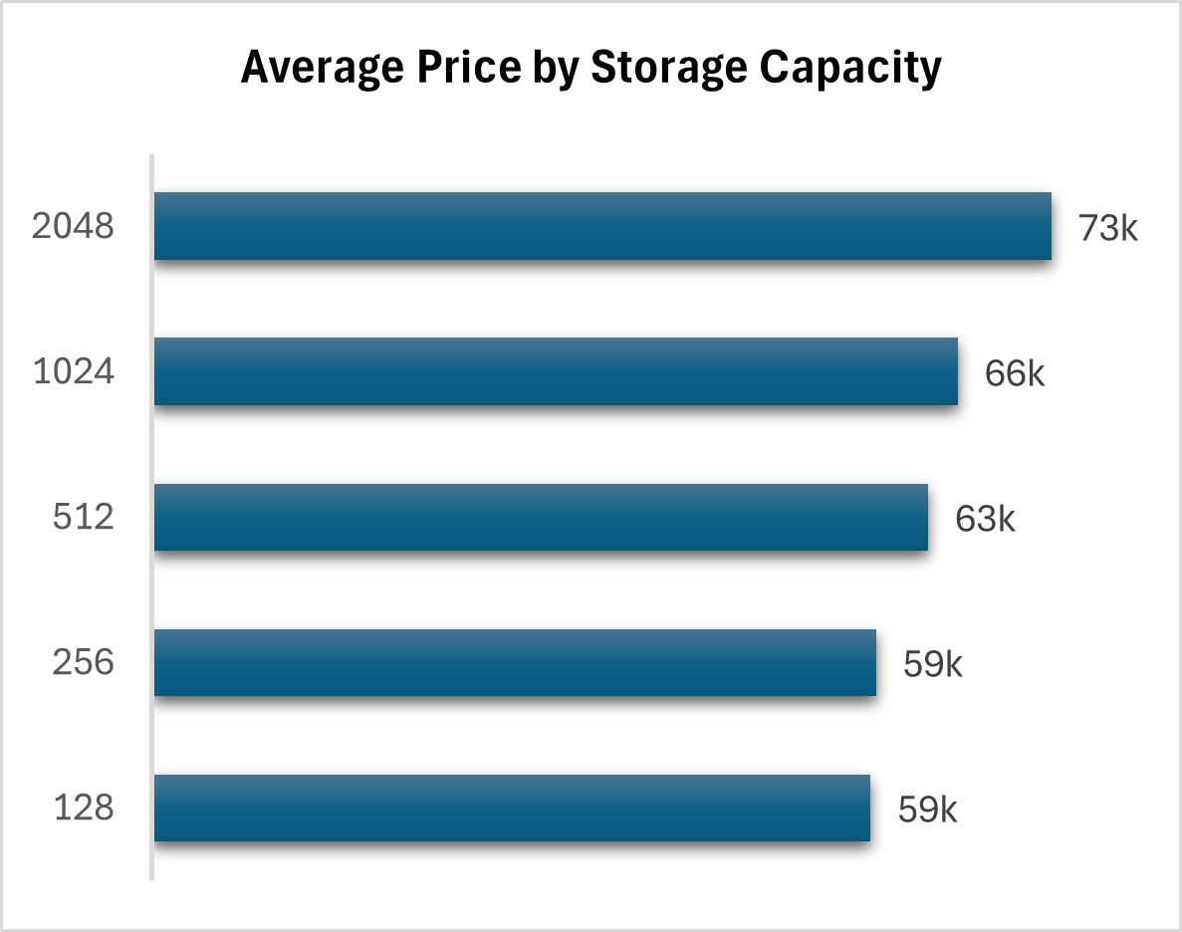
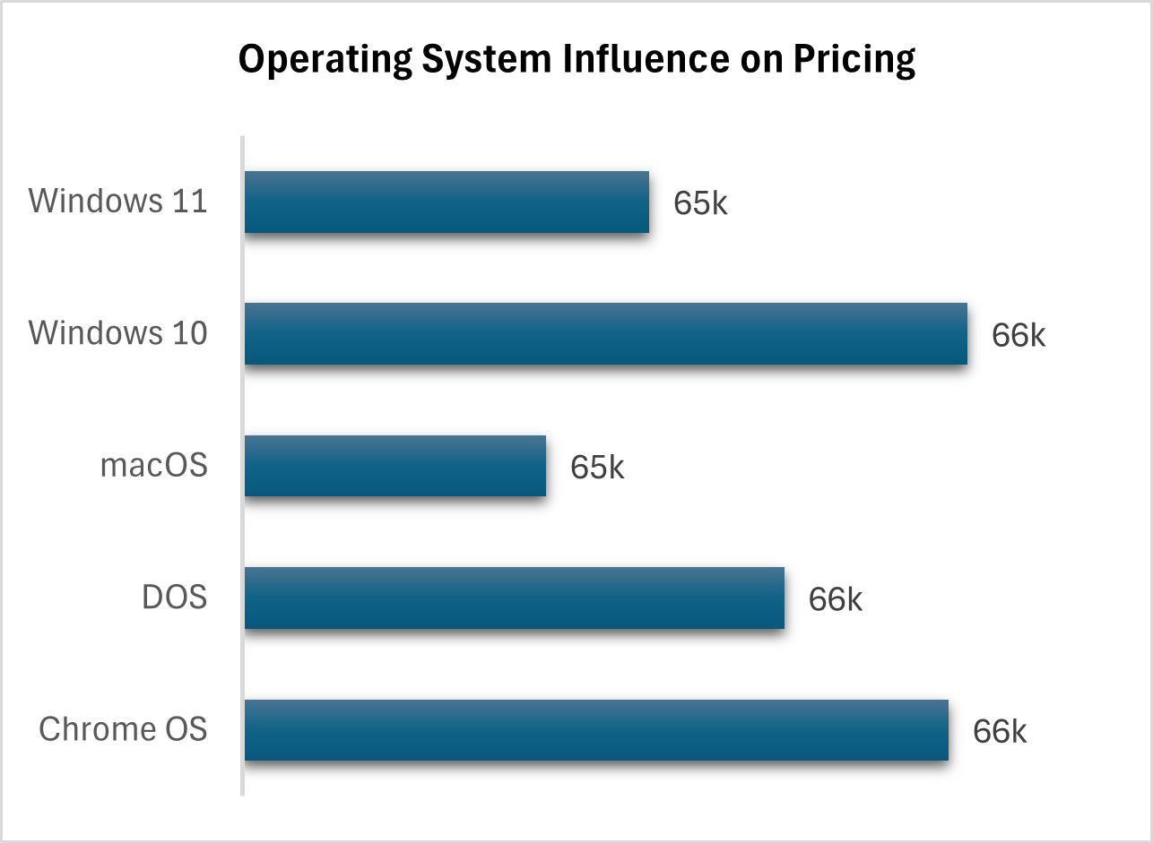

Major Insights
The analysis reveals that specifications have a weak influence on pricing, indicating that brand and market positioning play significant roles. Premium and luxury categories dominate market share, while mid-range laptops consistently deliver the best value-for-money, challenging traditional pricing perceptions and consumer expectations.

Slide 8
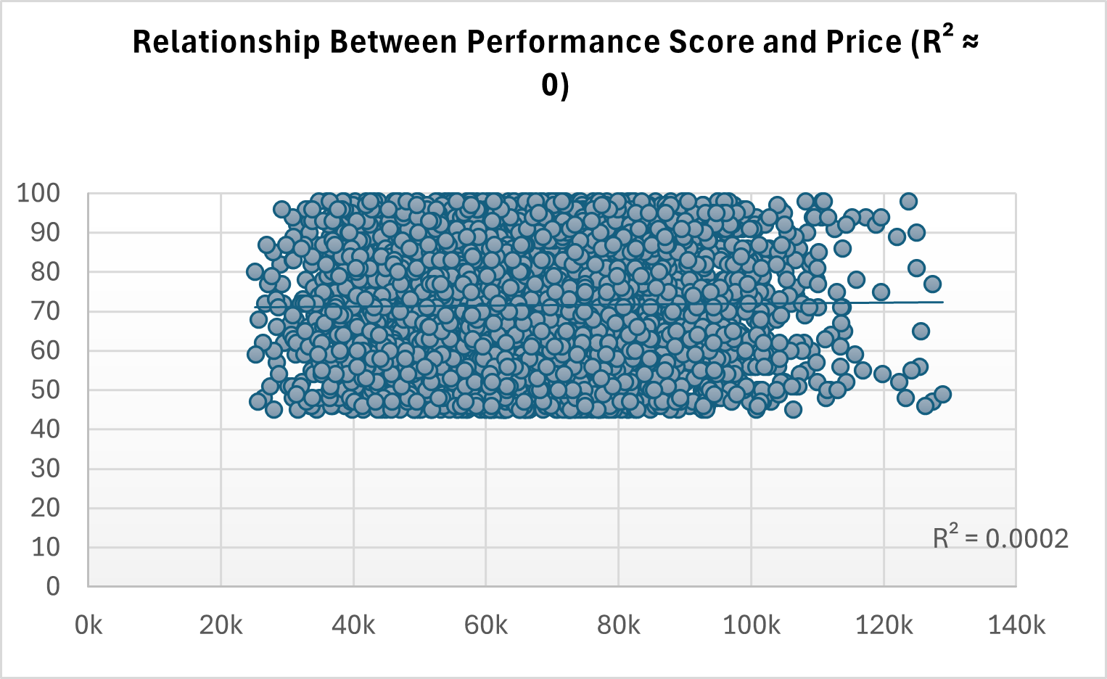
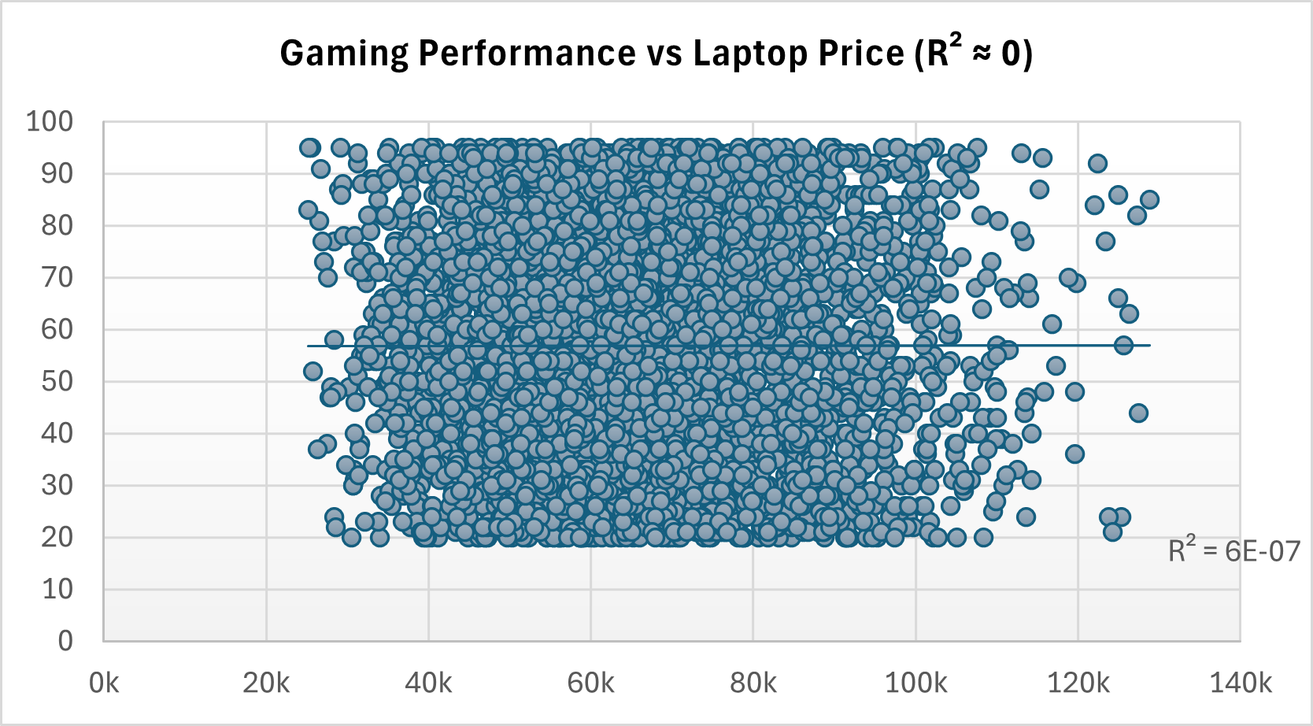
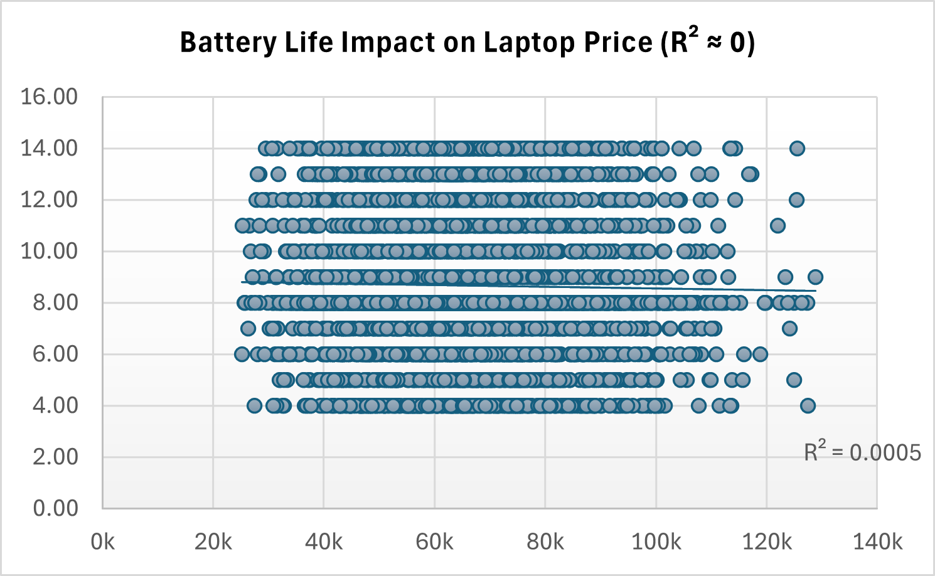
Performance Correlation
The correlation chart illustrates a R² value close to zero, indicating a minimal relationship between performance scores and laptop prices. This suggests that higher performance does not generally lead to increased pricing across the dataset.

Slide 9
Value-for-Money Analysis
Mid-Range Dominance
Brands in the mid-range category consistently offer superior value compared to premium options.
Identifying Top Brands for VFM
The analysis reveals the top brands that excel in delivering value-for-money, especially among mid-range laptops.
Brand Reputation
Trusted brands maintain a competitive edge in providing quality without excessive pricing.
BRAND | MODEL | CURRENT PRICE
Dell | Vostro 15 | 44833
Msi | Bravo 14 | 29249
Acer | Predator 17 | 52794
Lg | Gram 14 | 32853
Asus | Tuf 14 | 49062
Huawei | Matebook 17 | 40565
Dell | Vostro 16 | 42784
Apple | M2 | 71987
Samsung | Odyssey 14 | 26909
Huawei | Matebook 17 | 32151
Performance Balance
Successful brands achieve a balance between performance features and reasonable pricing for consumers.

Slide 10
Top 10 Overpriced Laptops
Apple Premium
Apple's products consistently showcase high prices driven by brand loyalty and perceived quality.
Examining Brand Premium Pricing Trends
This section highlights the top overpriced laptops, focusing on significant brand premiums from leading manufacturers.
Microsoft Influence
Microsoft laptops often carry added costs due to brand reputation and design innovation.
BRAND | MODEL | CURRENT PRICE
Apple | M1 | 124229
Apple | Macbook Air 14 | 125388
Apple | Macbook Pro 14 | 126330
Apple | Macbook Air 14 | 127432
Apple | Macbook Pro 16 | 127330
Apple | Macbook Air 17 | 119825
Microsoft | Surface Pro 15 | 114302
Apple | Macbook Air 17 | 128868
Apple | Macbook Air 15 | 125601
Apple | Macbook Air 14 | 123818
Market Trends
Current trends indicate that premium pricing does not always correlate with superior specs or performance.

Slide 11
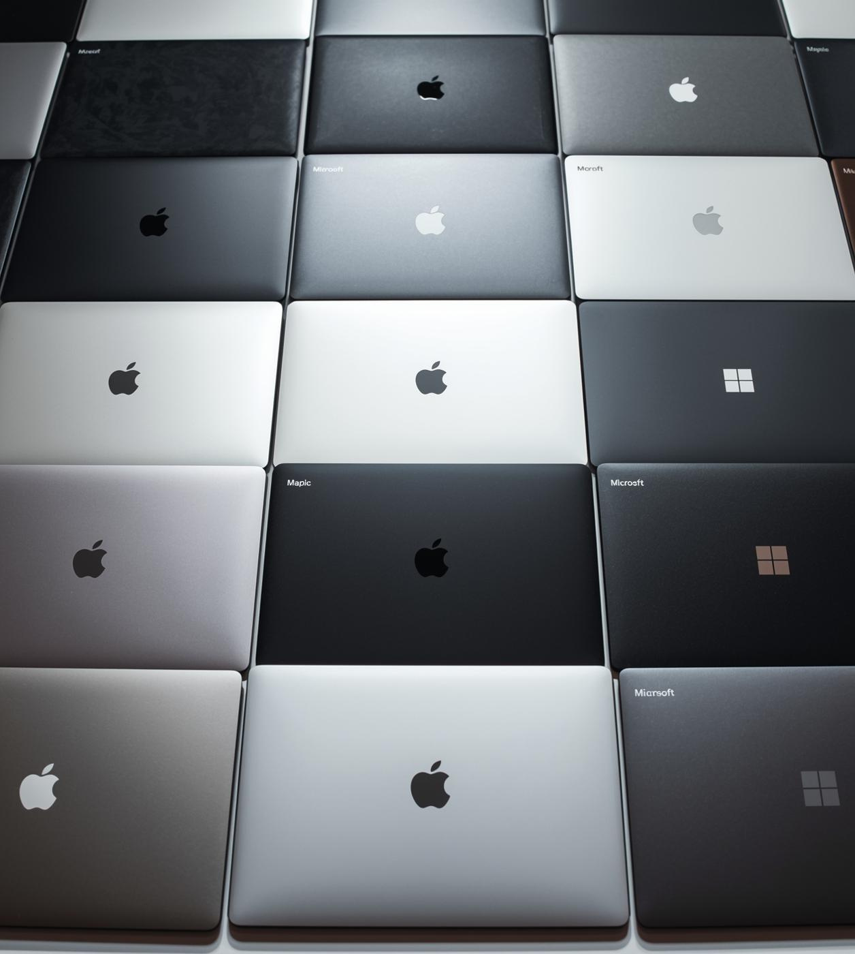
Brand Impact on Pricing
The analysis highlights that specifications alone do not dictate pricing; rather, brand reputation and market positioning play significant roles. Consumers often pay a premium for established brands, impacting their purchasing decisions and overall market dynamics. Understanding this can help buyers make informed choices in a crowded marketplace.

Slide 12

Recommendations
To maximize value, consumers should focus on mid-range laptops that offer the best performance for their budget. It's crucial to remain aware of brand premiums, which can inflate prices without significant benefits. Additionally, adopting transparent pricing strategies can foster informed purchasing decisions and enhance market trust.

Slide 13
Thank You for Your Attention!

